Slide 1

SQL Server Bolts to Buzzwords William Assaf Principal Consultant, Sparkhound
@william_a_dba

Slide 2

I Was Once
A Very
Crappy
Carpenter

Slide 3
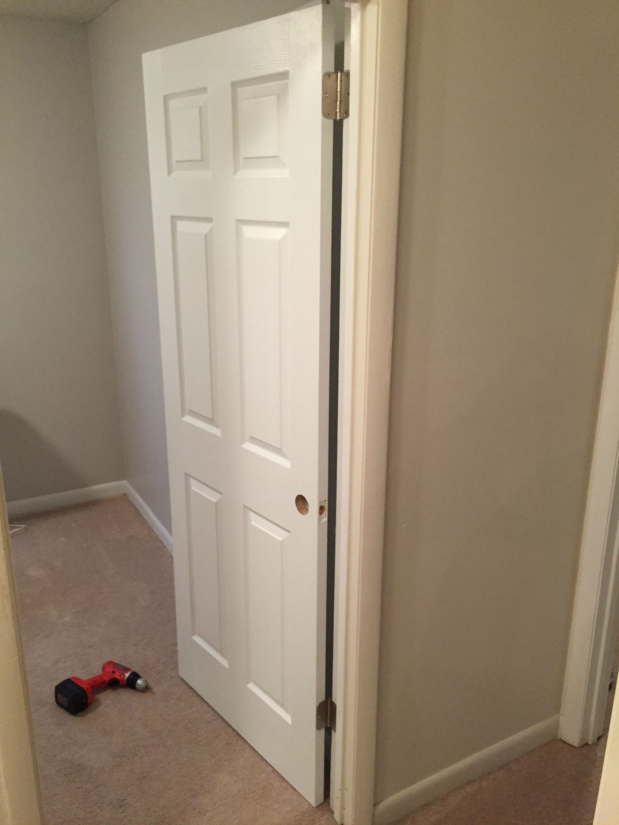

Slide 4
Side projects?
Outside interest?
Certification exams?
User Groups?
Nope.
Notes:
SLIDE PURPOSE: This is where everything starts – us defining with our customers how we can make an impact in their business regardless of the technology!
SPIEL: Technology should be transformative, not a to-do list. Because, really, just about any firm can change the way your IT works. Our mission is for IT to change the way your business works. The difference is a game-changer.

Slide 5
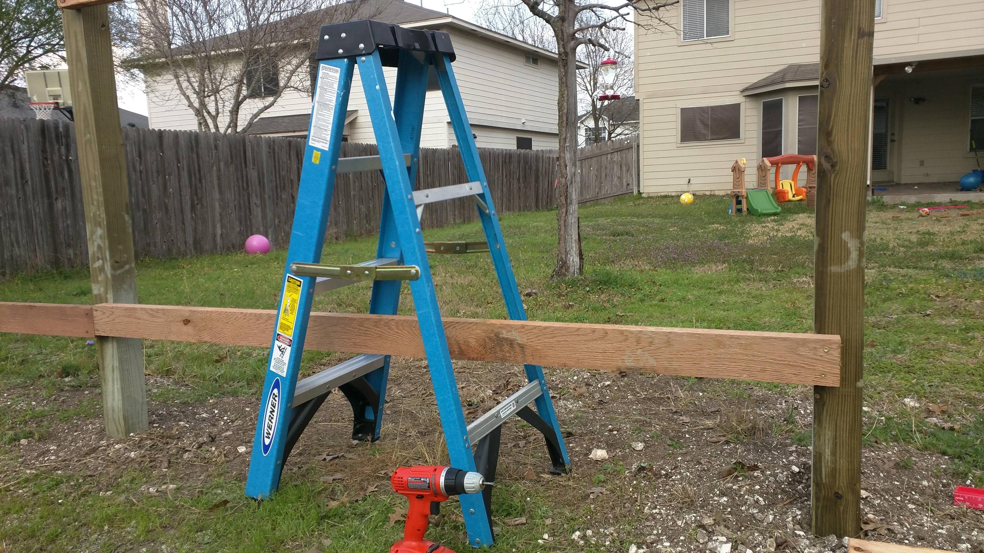
Notes:
SLIDE PURPOSE: This is where everything starts – us defining with our customers how we can make an impact in their business regardless of the technology!
SPIEL: Technology should be transformative, not a to-do list. Because, really, just about any firm can change the way your IT works. Our mission is for IT to change the way your business works. The difference is a game-changer.

Slide 6
I just did what I was told. I didn’t really try to expand my skillset.
Was just doing the job.
And I made little goofs all the time because it was just a job.
Notes:
SLIDE PURPOSE: This is where everything starts – us defining with our customers how we can make an impact in their business regardless of the technology!
SPIEL: Technology should be transformative, not a to-do list. Because, really, just about any firm can change the way your IT works. Our mission is for IT to change the way your business works. The difference is a game-changer.

Slide 7
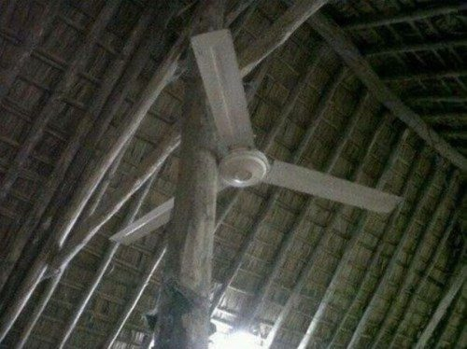

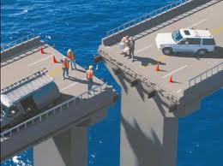
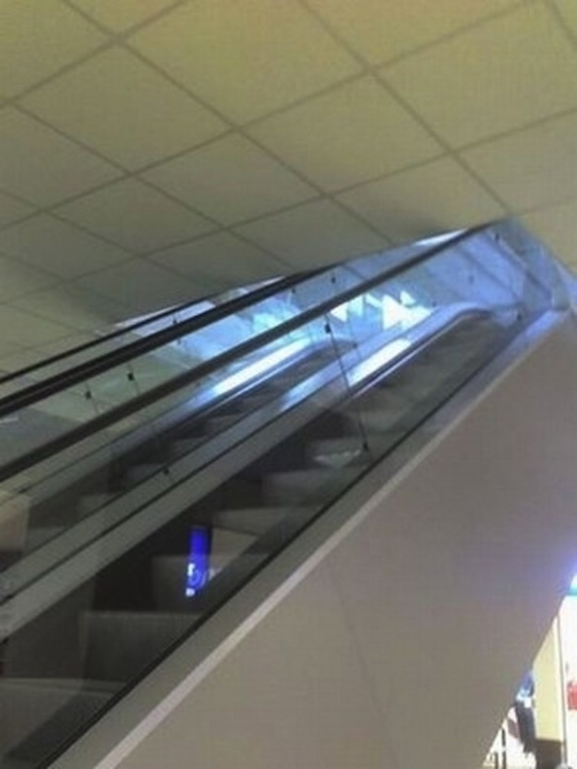
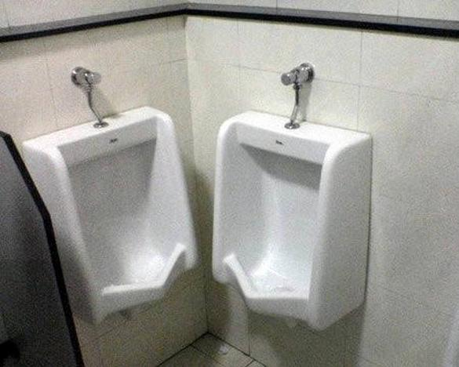
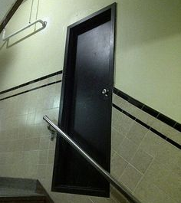
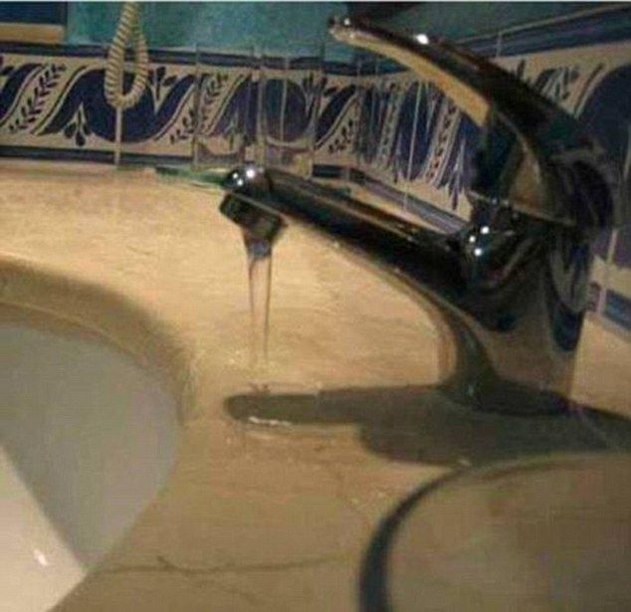
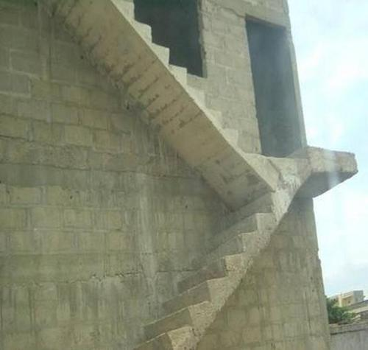
Notes:
SLIDE PURPOSE: This is where everything starts – us defining with our customers how we can make an impact in their business regardless of the technology!
SPIEL: Technology should be transformative, not a to-do list. Because, really, just about any firm can change the way your IT works. Our mission is for IT to change the way your business works. The difference is a game-changer.

Slide 8
I wasn’t a very good carpenter.
I wanted be a better carpenter, but couldn’t find time to make myself into one.
That was my employer’s responsibility...
…right?
Notes:
SLIDE PURPOSE: This is where everything starts – us defining with our customers how we can make an impact in their business regardless of the technology!
SPIEL: Technology should be transformative, not a to-do list. Because, really, just about any firm can change the way your IT works. Our mission is for IT to change the way your business works. The difference is a game-changer.

Slide 9
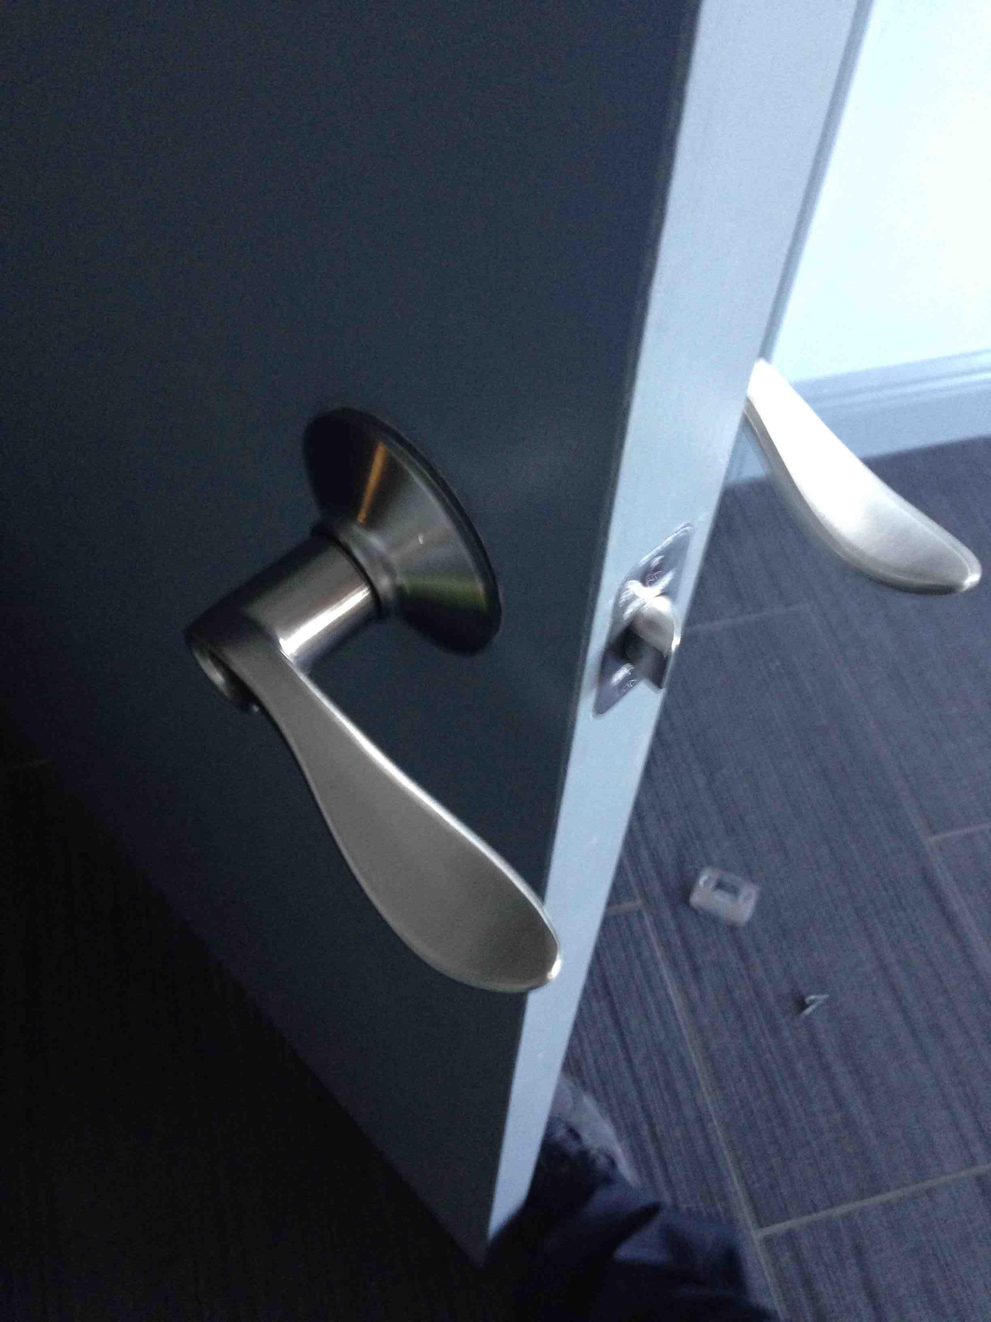
Notes:
SLIDE PURPOSE: This is where everything starts – us defining with our customers how we can make an impact in their business regardless of the technology!
SPIEL: Technology should be transformative, not a to-do list. Because, really, just about any firm can change the way your IT works. Our mission is for IT to change the way your business works. The difference is a game-changer.

Slide 10
In your career, sometimes we find
that what we want to be
and what we do every day aren’t the same thing.
Who’s problem is that?
Notes:
SLIDE PURPOSE: This is where everything starts – us defining with our customers how we can make an impact in their business regardless of the technology!
SPIEL: Technology should be transformative, not a to-do list. Because, really, just about any firm can change the way your IT works. Our mission is for IT to change the way your business works. The difference is a game-changer.

Slide 11
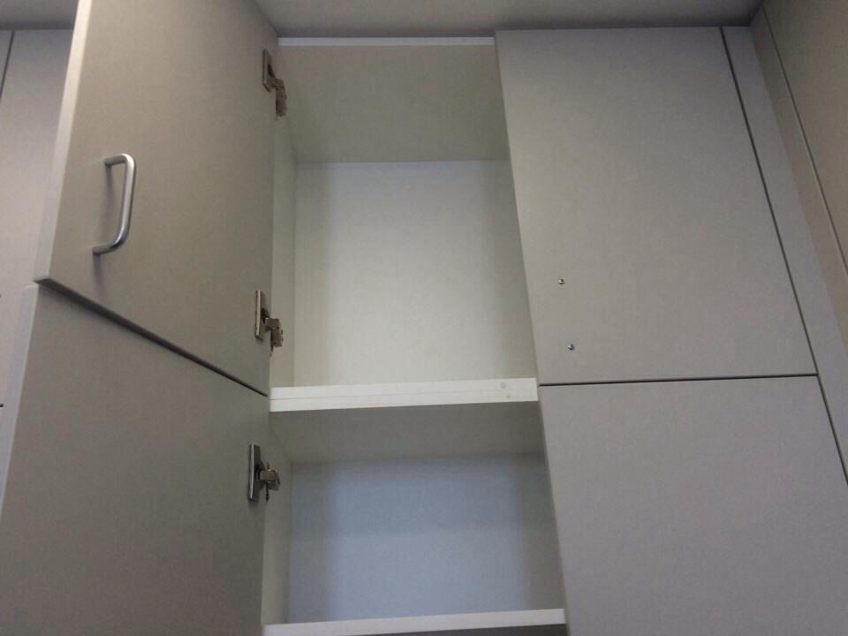
Notes:
SLIDE PURPOSE: This is where everything starts – us defining with our customers how we can make an impact in their business regardless of the technology!
SPIEL: Technology should be transformative, not a to-do list. Because, really, just about any firm can change the way your IT works. Our mission is for IT to change the way your business works. The difference is a game-changer.

Slide 12
So I started studying.
Showed interest, paid more attention, did more than the minimum.
Found myself some side projects to work on. I kept busy.
Studied. Passed a certification exam.
And THEN an opportunity for a good work situation came up, and I surrounded myself with experience.
THAT is when my career took off.
Notes:
SLIDE PURPOSE: This is where everything starts – us defining with our customers how we can make an impact in their business regardless of the technology!
SPIEL: Technology should be transformative, not a to-do list. Because, really, just about any firm can change the way your IT works. Our mission is for IT to change the way your business works. The difference is a game-changer.

Slide 13
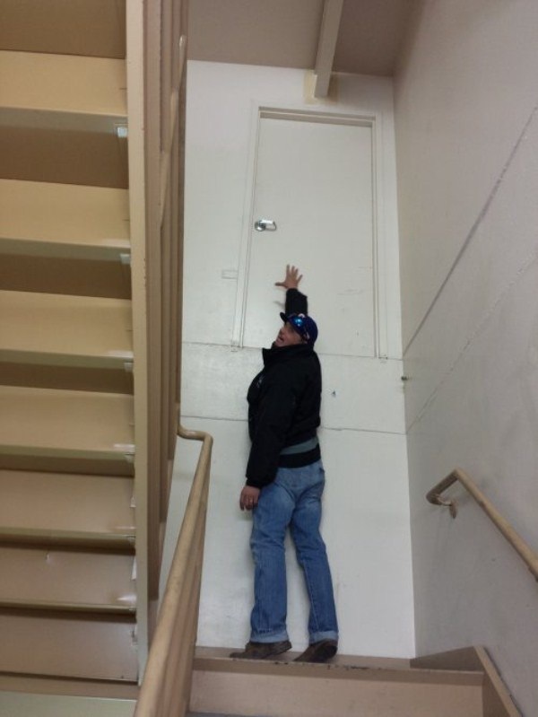
Notes:
SLIDE PURPOSE: This is where everything starts – us defining with our customers how we can make an impact in their business regardless of the technology!
SPIEL: Technology should be transformative, not a to-do list. Because, really, just about any firm can change the way your IT works. Our mission is for IT to change the way your business works. The difference is a game-changer.

Slide 14
I had started learning again, which I forgot how to do at some point during my senior year of college.
Did I still make mistakes at work?
Sure.
But I was on the path.

Slide 15
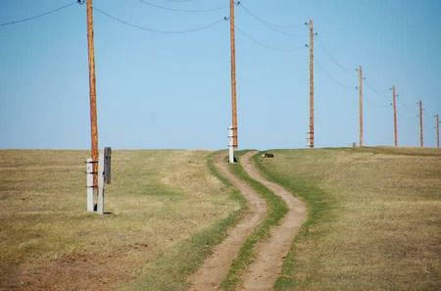
Notes:
SLIDE PURPOSE: This is where everything starts – us defining with our customers how we can make an impact in their business regardless of the technology!
SPIEL: Technology should be transformative, not a to-do list. Because, really, just about any firm can change the way your IT works. Our mission is for IT to change the way your business works. The difference is a game-changer.

Slide 16
You are not a very good carpenter,
if your own house isn’t full of the tools of your trade and your own projects. The only way to learn is to do.
Don’t expect to learn everything from your job.
Notes:
SLIDE PURPOSE: This is where everything starts – us defining with our customers how we can make an impact in their business regardless of the technology!
SPIEL: Technology should be transformative, not a to-do list. Because, really, just about any firm can change the way your IT works. Our mission is for IT to change the way your business works. The difference is a game-changer.

Slide 17
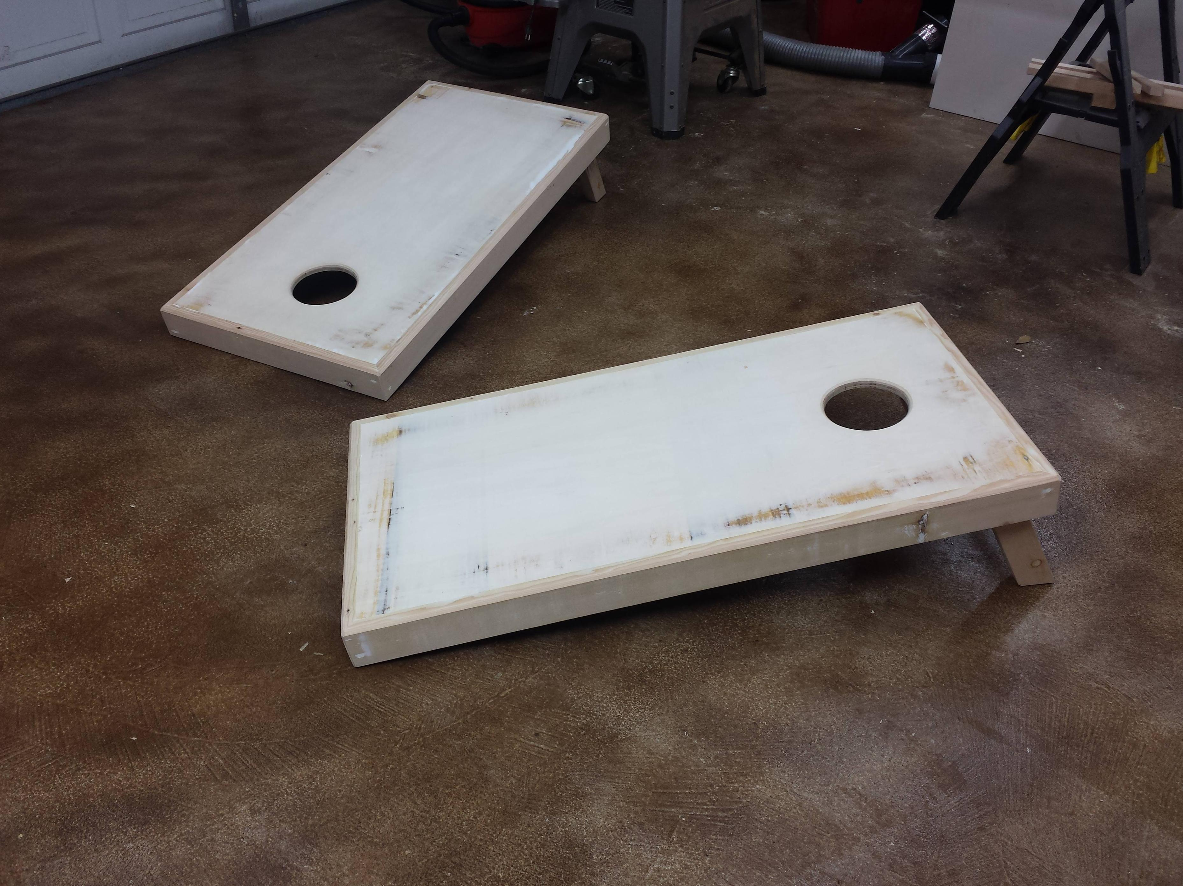
Notes:
SLIDE PURPOSE: This is where everything starts – us defining with our customers how we can make an impact in their business regardless of the technology!
SPIEL: Technology should be transformative, not a to-do list. Because, really, just about any firm can change the way your IT works. Our mission is for IT to change the way your business works. The difference is a game-changer.

Slide 18
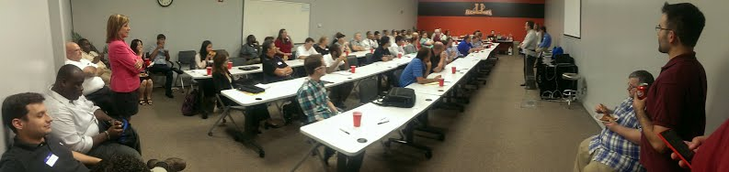
“So what do I do?”
Notes:
SLIDE PURPOSE: This is where everything starts – us defining with our customers how we can make an impact in their business regardless of the technology!
SPIEL: Technology should be transformative, not a to-do list. Because, really, just about any firm can change the way your IT works. Our mission is for IT to change the way your business works. The difference is a game-changer.

Slide 19

Join SQL PASS (sqlpass.org) or other tech organization for your field
Attend your local User Group, like this one (BRSSUG.org has links in the region)
Join a Virtual User Groups
Go to SQL Saturdays (around the world!)
SQLSaturday.com
Every August in Baton Rouge
Volunteer for SQL Saturday
All this stuff is really good for your professional networking!

Slide 20
Write a blog post explaining a topic in your field
Give a lunch and learn at your office
Give a Lightning Round talk to BRSSUG
Give a presentation to BRSSUG
Give a presentation at SQL Saturday
Share your experience and knowledge with your community, where ever it ends up being, because the more skilled professionals doing good IT work there are in your city, the more good IT work for us to do

Slide 21
It is true that you will almost never get a good job
where someone inside
didn’t already know about you.
Notes:
SLIDE PURPOSE: This is where everything starts – us defining with our customers how we can make an impact in their business regardless of the technology!
SPIEL: Technology should be transformative, not a to-do list. Because, really, just about any firm can change the way your IT works. Our mission is for IT to change the way your business works. The difference is a game-changer.

Slide 22
Also:
Get organized. Get a task list, keep a calendar.
The method and idea needs to be YOURS.
Who doesn’t view threaded emails?
Stop fearing being wrong, start fearing becoming obsolete. Stay technical!
Learn to admit when you’re wrong, and stop wasting time covering it up.
Think you understand something? Find out for real. Try blogging about it, or speaking about it.
Have a can-do attitude.
Don’t be a fault-finder or flaw-seeker
Don’t think of roadblocks as a default method of contributing to discussion.

Slide 23
Start treating your coworkers and colleagues in the community like friends, not like coworkers and colleagues.
Never pass up an opportunity to give someone a sincere "Great job!"
Don’t ever ask a woman if she is pregnant.
Don’t ever ask a woman if she is a “booth babe”. OMGWTFBBQ
Don’t hate.
Caffeinate.

Slide 24
SQL Server Bolts to Buzzwords William Assaf Principal Consultant, Sparkhound

Slide 25
Database Server Terminology
SQL - pronounced "sequel", not ESS KEW ELL
ANSI SQL is an international standard for Structured Query Languages.
Microsoft's database platform that is aligned with the SQL Standard is "SQL Server"
Oracle's is called "Oracle"
IBM's is called "DB2“
Others: MySQL, PostgreSQL.

Slide 26
Database Server Terminology
Database platforms provide ACID transactions:
Atomicity - transactions commit and roll back as a whole.
Consistency - series of rules and constraints are enforced, such as data typing, relational integrity, constraints, triggers.
Isolation - concurrent transactions occur serially.
Durability - transactions commit to non-volatile storage and once committed, can be recovered in the event of a power loss.

Slide 27
Database Server Terminology
Big Data: "NoSQL" database platforms are emerging for extremely large or sharded datasets, for example:
Cassandra is the database engine that runs Twitter.

Slide 28
Database Server Terminology
Apache Hadoop is an open-source data file clustering platform. Apache Hive is a Data Warehousing platform for Big Data (developed by Facebook) that runs on Hadoop.
SQL Server has a distribution for Hadoop called HDInsight.

Slide 29
Database Server Terminology
The latest movements in Big Data are to provide SQL-like programming environments, so that today's developers can be tomorrow's BigData developers using a similar language platform.

Slide 30
Database Server Terminology
The term "Polyglot Programming" describes the principles that for applications of large enough size, a mix of different technologies will be needed to accomplish all the tasks, not just one.
"NoSQL" databases will never replace relational databases, but they have new and emerging uses in the Information Era that relational databases struggle to meet with performance.
Notes:
Could you write Twitter in MS SQL Server? Yes. Would it scale? No.
Cassandra is not ACID compliant. Is that a bad thing? No.
Promises "Eventual" consistency by quorum

Slide 31
Database Server Terminology
Big clients for SQL Server:
MySpace (1.5 billion page views per day at peak)
GoDaddy (27k transactions per second)
Bwin (30k transactions per second)
Cintas (3k image transactions per second replicated over WAN)
Klout (Apache Hadoop adapter for BI processes 350mil new rows/day)
Trend Micro (55TB and growing)
NASDAQ (all trading history)
Notes:
NASDAQ outage caused by SQL injection

Slide 32
Microsoft SQL Server
Microsoft SQL Server Versions: SQL 6.5, 7, 2000, 2005, 2008, 2008 R2, 2012, 2014, 2016 (currently in preview)
Microsoft SQL Server Editions: Licensing
Express (free), Standard ($hundreds), Business Intelligence (2012+) ($$thousands), Enterprise ($$$thousands)
Why Enterprise? For larger data sets, it comes with features like compression, military-level auditing, data partitioning, encryption, and the new Tabular Mode for SSAS (more on that later)

Slide 33
OLTP vs OLAP
Transactional Read/Write Database (OLTP):
A database that is designed for read-write queries to keep a business system accurate.
It usually contains historical data, but in transactional ("line item" or "ledger") format, not aggregated.
Traditional "normalized" application database.

Slide 34
OLTP vs OLAP
Data Warehouse (OLAP):
A database that is designed for querying and analysis rather than for transaction processing.
It is optimized for read-only queries. It is written on regular intervals (nightly, hourly).
It usually contains historical data derived from Transactional data (see above), but it can include data from other sources.
The data is aggregated for easy consumption by Business Intelligence.
Design is "flattened", de-normalized, includes redundant data across multiple tables.

Slide 35
More on OLAP
Data Cube:
Proprietary, specialized data storage that on top of a Data Warehouse.
A cube is a (usually) read-only structure that stores aggregated calculations, for fast and easy presentation.
"Measures" are pre-aggregated by many "dimensions". A number is averaged for many different describers and filters.
For example: Sales by region by salesperson by product type, from last year to now
Decision makers perform their analysis against selected cubes to monitor and forecast business trends.
Microsoft SQL Server's "data cube" product is SQL Server Analysis Services (SSAS).

Slide 36
Database Concepts
ETL (Extract, Transform and Load)
The first part of an ETL process is to extract the data from the heterogeneous raw source systems (other database engines (DB2, Oracle), flat files, excel files)
An ETL process merges and compiles data into the new database design.
Multiple ETL's can be used to take data from heterogeneous raw Source -> Transactional System -> Data Warehouse.
SQL Server's "ETL" product is called Integration Services (SSIS).
Used to be called "DTS" in SQL 2000.

Slide 37
SQL Server Components
Database Component (SQL Server) - store data
Integration Services (SSIS) - move data
Reporting Services (SSRS) - show data
Native or SharePoint integrated mode
Analysis Services (SSAS) - sum data
Bunch of other little stuff in the license

Slide 38
Relational Database Concepts
Microsoft SQL Server Business Intelligence related applications:
Excel
Excel PowerPivot
PerformancePoint (exists inside SharePoint)
PowerView
Report Builder

Slide 39
SQL Server Disaster Recovery
Rule #1 of SQL Disaster Recovery: SQL must back up SQL.
SQL is an enterprise-ready tool that comes with everything you need to back it up.
Third-party Enterprise level backup software (BackupEXEC, Avamar) can also handle SQL backup scenarios too, but by calling SQL Server via an API.

Slide 40
SQL Server Disaster Recovery
Rule #2: The transaction log is important and must be backed up.
This is the #1 problem. "Transaction log file filled up my drive!"
Must be backed up regularly. (10-60 min is typical) (RPO)
The transaction log is backed up to achieve Point in Time Recovery.
If you don’t want Point in Time Recovery, place the database in SIMPLE recovery mode, instead of FULL (default).

Slide 41
SQL Server Disaster Recovery
Rule #2: The transaction log is important and must be backed up.
This is the #1 problem. "Transaction log file filled up my drive!"
Must be backed up regularly. (10-60 min is typical) (RPO)
The transaction log is backed up to achieve Point in Time Recovery.
If you don’t want Point in Time Recovery, place the database in SIMPLE recovery mode, instead of FULL (default).

Slide 42
SQL Server Disaster Recovery
Point in Time Recovery
If a disaster happens (lose the disks) at 3:05pm and I took a transaction log backup at 3:00pm, I lost only 5 min of data
If doofus dropped a table at 2:55pm, I can restore the database up to 2:54:59.

Slide 43
SQL Server Disaster Recovery
RPO - Recovery Point Objective
“Data Loss Tolerance“
For values >=5min, Transaction Log backups
For values <5min, Mirroring or new SQL 2012 feature Availability Groups or "AlwaysOn"
HADRON High Availability Disaster Recovery Online
RTO - Recovery Time Objective
Prioritize applications and systems for recovery after a disaster

Slide 44
SQL Server Data Types 101
Numbers - Integers
Data type | Range | Storage
bigint | -2^63 (-9,223,372,036,854,775,808) to 2^63-1 (9,223,372,036,854,775,807) | 8 Bytes
int | -2^31 (-2,147,483,648) to 2^31-1 (2,147,483,647) | 4 Bytes
smallint | -2^15 (-32,768) to 2^15-1 (32,767) | 2 Bytes
tinyint | 0 to 255 | 1 Byte

Slide 45
SQL Server Data Types 101
Numbers - Decimal (precision, scale)
Data type | Range | Storage
Decimal (or numeric) | - 10^38 +1 through 10^38 - 1. | Precision, bytes 1 – 9, 5 10-19, 9 20-28, 13 29-38, 17
Always use
Decimal (9,2)
Decimal (19,2)
Decimal (28,2)
Declare @mynumber Decimal(19, 4)

Slide 46
SQL Server Data Types 101
POP QUIZ
When should you use the float or real data types?
Never
Never ever
Never ever ever never
Never never never never never everneverland
Well, sometimes? Nope. Never.

Slide 47
SQL Server Data Types 101
Words – varchar and char
Data type | Range | Storage
Varchar | Just about every letter you know from Western languages, even the funny looking ones | ALWAYS provide a length Actual data + 2 bytes
Char | Just about every letter you know from Western languages, even the funny looking ones | ALWAYS provide a length Actual data bytes

Slide 48
SQL Server Data Types 101
Words – nvarchar and nchar
Data type | Usage | Storage
Nvarchar | All languages, plus internal SQL Server values/strings | ALWAYS provide a length (Actual data * 2) + 2 bytes
Nchar | All languages, plus internal SQL Server values/strings | ALWAYS provide a length Actual data bytes * 2

Slide 49
SQL Server Data Types 101
Words – text and ntext
No.

Slide 50
SQL Server Data Types 101
Words – nvarchar(max) and nchar(max)
Data type | Usage | Storage
varchar(max) | When you want to piss off your DBA Or Store >8000 characters up to 2gb of text | Actual data + 2 bytes
nvarchar(max) | When you want to piss off your DBA Or Store >8000 characters up to 2gb of UNICODE text | (Actual data * 2) + 2 bytes
No.

Slide 51
SQL Server Data Types 101
Dates date, datetime, datetime2, datetimeoffset, smalldatetime, Time
Data type | Usage
date | MM/DD/YYYY
Datetime2(n) | MM/DD/YYYY HH:MM:(n fractional seconds)
datetimeoffset(n) | MM/DD/YYYY HH:MM:(n fractional seconds) +-Hours
Time(n) | HH:MM:(n fractional seconds)
datetime | Deprecated
smalldatetime | Deprecated

Slide 52
SQL Server Data Types 101
There is also:
Spatial
XML
Bit (NOT THE SAME as .NET’s Boolean)
Sql_variant
Uniqueidentifier (GUID, avoid)

Slide 53
LA DOTD ARRA Project Model
Time Permitting?

Slide 54
User Groups
Hammond .NET User Group
http://SLUnug.azurewebsites.net/
Baton Rouge .NET User Group
brdnug.org
Next meeting: October 14
Every second Wednesday
Baton Rouge SQL Server User Group
brssug.org

Slide 55

Bio and Contact
William D Assaf, MCSE
Vice President, Baton Rouge SQL Server User Group
Principal Consultant, Team Lead
Sparkhound Inc., William.Assaf@sparkhound.com
@william_a_dba
This presentation, including all source code and this slide deck, will be posted at my blog:
SQLTact.com

